Slide 1
碩博士提口試步驟
Procedure for a Dissertation Defense

Slide 2

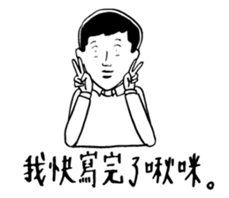
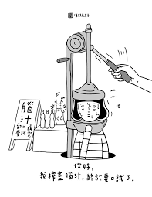
口試申請 Application
你家老闆大人今天終於答應你可以提口試~~
你必須在115.07.15前提出口試申請，錯過要再等到新學期開始喔~
Please apply the dissertation defense before Jul 15th.
Otherwise, you may missed the deadline and please apply to the next semester.

Slide 3

口試申請 Application
Step 1.
你需先請示老闆大人要拜託哪位教授擔任口試召集人，並邀請哪幾位教授當你的口委。
At first, you may discuss with your director professor, and confirm which professor would become your convener, and invited who be your committee members.

Slide 4
口試申請 Application
Step 2.
確認口試時間及地點。
本系適合口試有兩間場地-(CH209&CH011)
請利用本系現上教室預約系統預約時間。
http://chem.thu.edu.tw/web/page/page.php?scid=91&sid=126
Confirm the date and place for your dissertation defense.
CH209 and CH011 would recommend to use.
Please check the website to reserve the space.
http://chem.thu.edu.tw/web/page/page.php?scid=91&sid=126

Slide 5
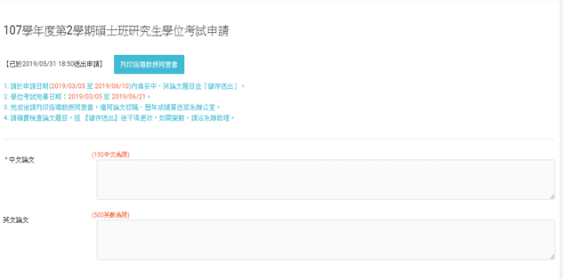
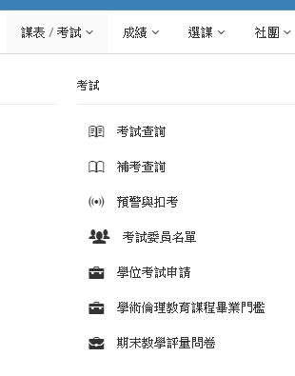
口試申請 Application
Step 3.
領旨後，需至學生資訊系統→學位考試申請填寫跟他糾纏兩年的論文題目，送出後列印教授指導同意書 (通關素材一)，蓋上玉璽 (教授簽名)。
Logging in your student system, choose”學位考試申請” and type all of the details about your thesis, and print the document to your professor for signing.

Slide 6
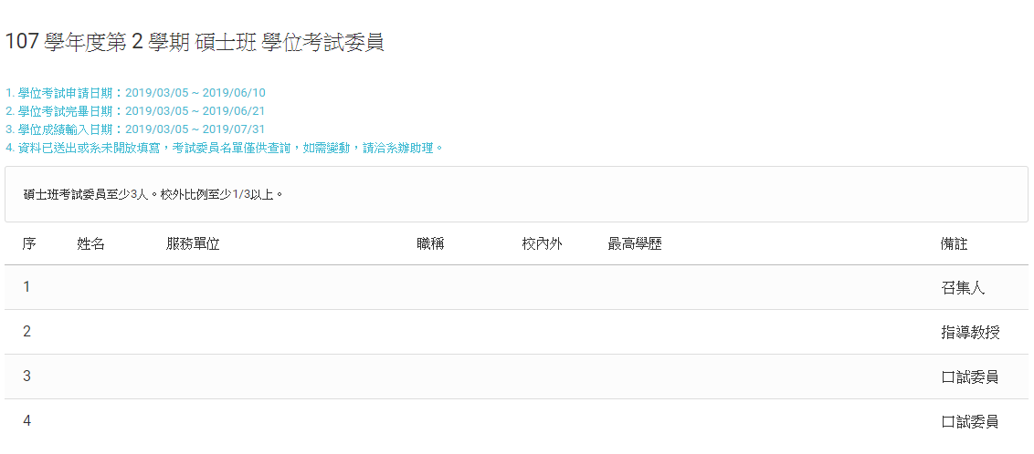
口試申請 Application
Step 4.
至學生資訊系統→考試委員名單填寫口試委員相關資料，送出。
Filling up the details of committee members in student system.

Slide 7
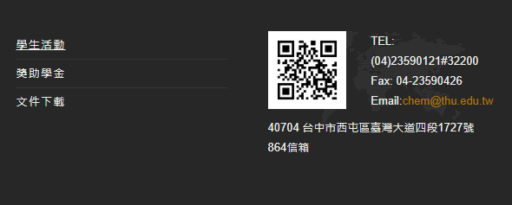
口試申請 Application
Step 5.
至化學系網頁文件下載→化學系研究生論文口試學位論文專業檢核表(通關素材二)填寫學號、姓名及論文題目，經指導教授及檢核委員簽名。
Download”化學系研究生論文口試學位論文專業檢核表”from Chemistry website, and fill up your Student ID, name, and thesis. Please print and let your professor and committee members sign.

Slide 8
口試申請 Application
Step 6.
列印你的論文初稿、論文原創性比對報告(需本人及指導教授簽名、壓日期) 、歷年成績單及論文壁報展出證明(通關素材三、四、五及六) 。
Print your whole thesis (first draft), transcript (all academic years), and the proof of your thesis poster.
補充說明：此初稿只是為證明你有資格申請口試，不需華麗包裝，待口試申請結束後就會還給你還給你還給你。
Notes: The first draft of thesis would be returned to you after confirming your qualification of dissertation defense.

Slide 9
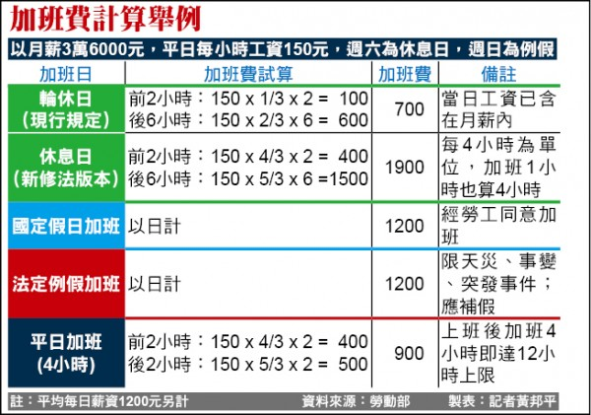

口試申請 Application
Step 7.
帶著你那五樣通關素材，並於上班時間(請參考下表)至系辦，超過時間請參考加班費計算表。
Please bring whole printed document (orange underline) to Office.
 | 上班日期 | 上班時間
Winter summer vacation | Mon. - Thu. | 8:00~12:00；13:30~16:00
Semester | Mon. - Fri. | 8:00~12:00；13:30~17:00

Slide 10
口試申請 Application
Step 8.
告訴承辦人你的口試時間及地點，送出後列印研究生學位考試申請表 (通關素材七)。
口試申請完成，後續系辦及學校會幫你處理。
Giving your date and location to office, and print“研究生學位考試申請表”.
Your application procedure would be confirmed and deal with by office.
(To be continued……)

